Slide 1


Slide 2


Slide 3
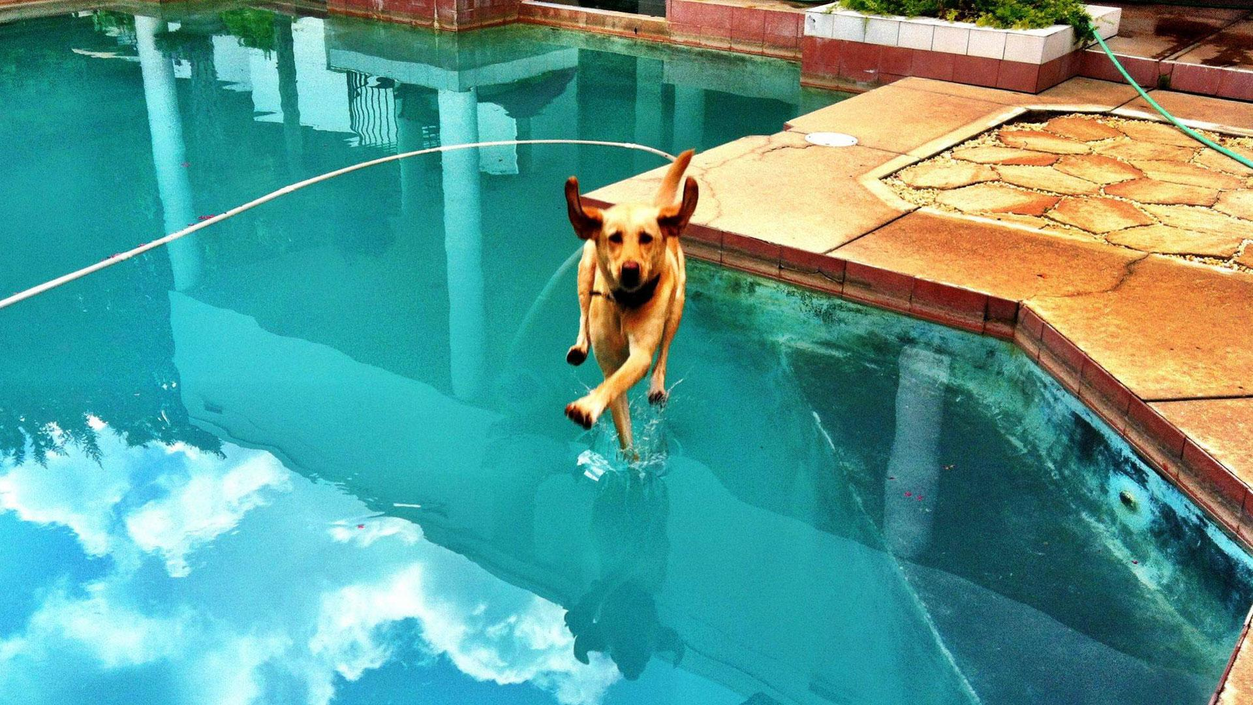

Slide 4


Slide 5
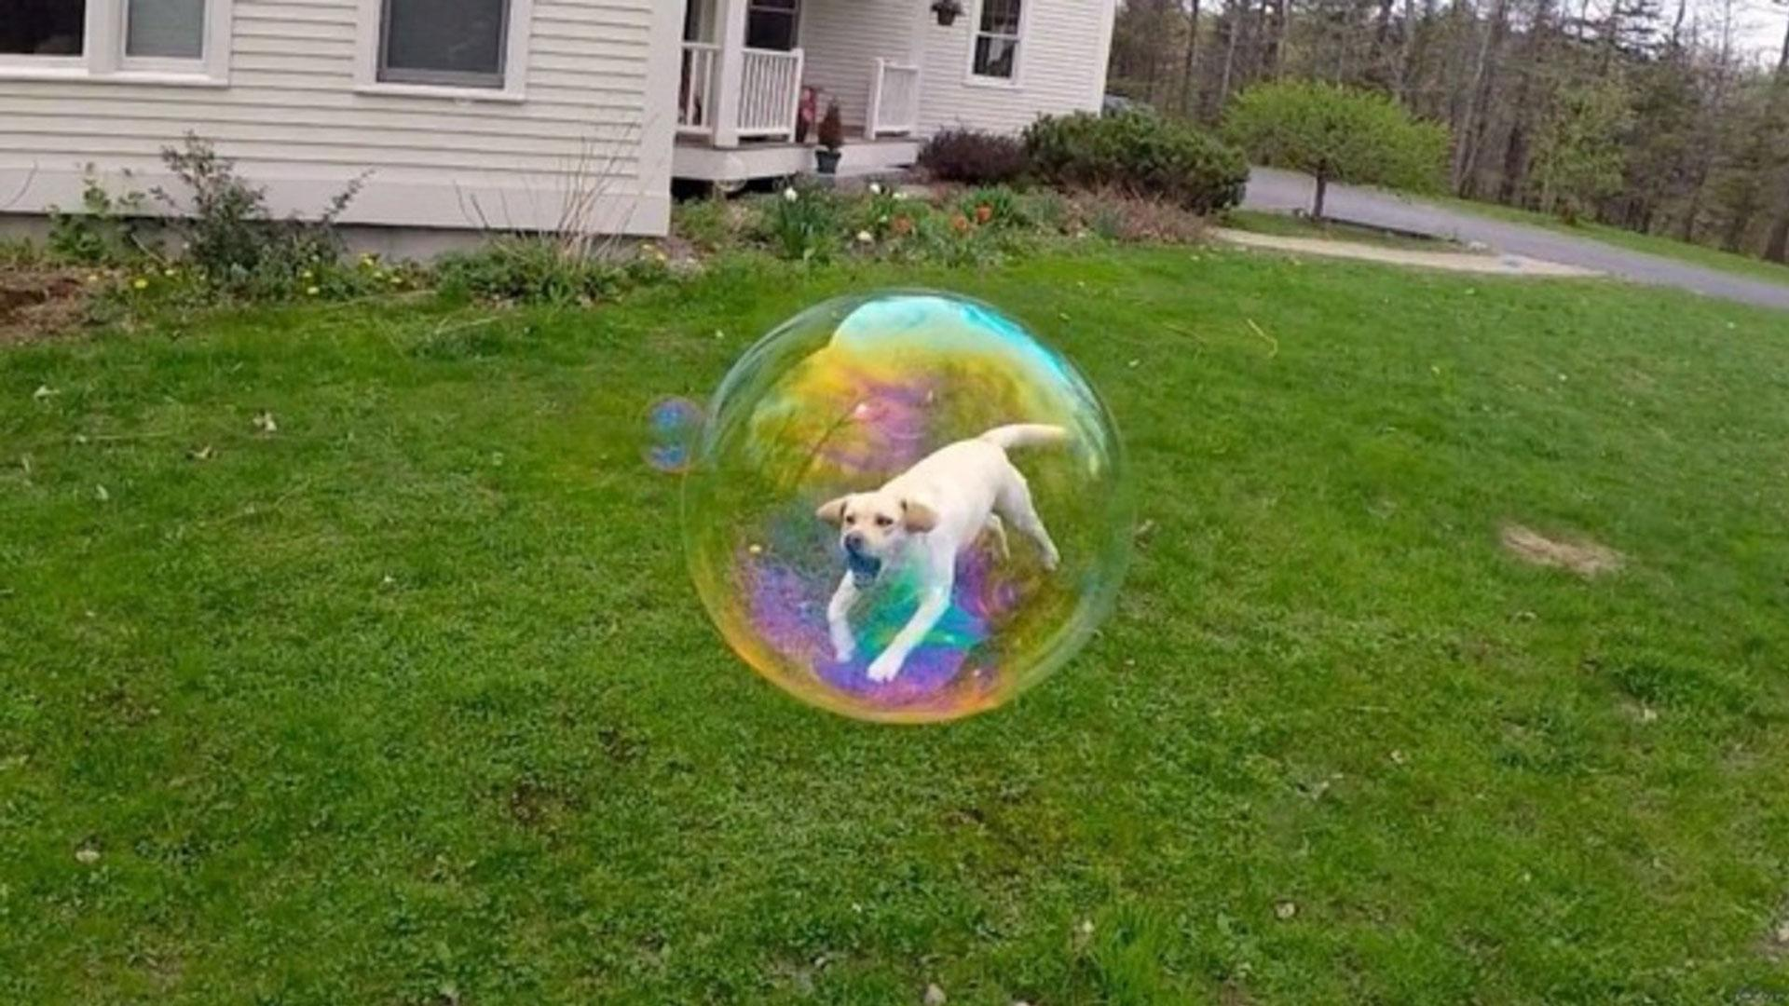

Slide 6
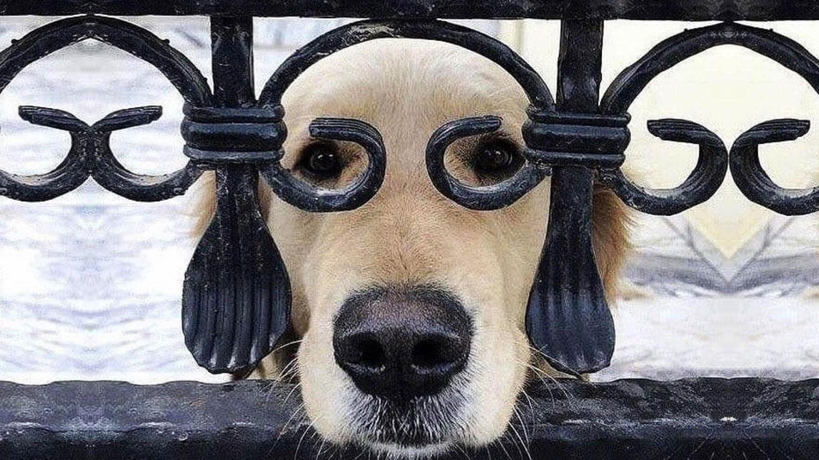

Slide 7
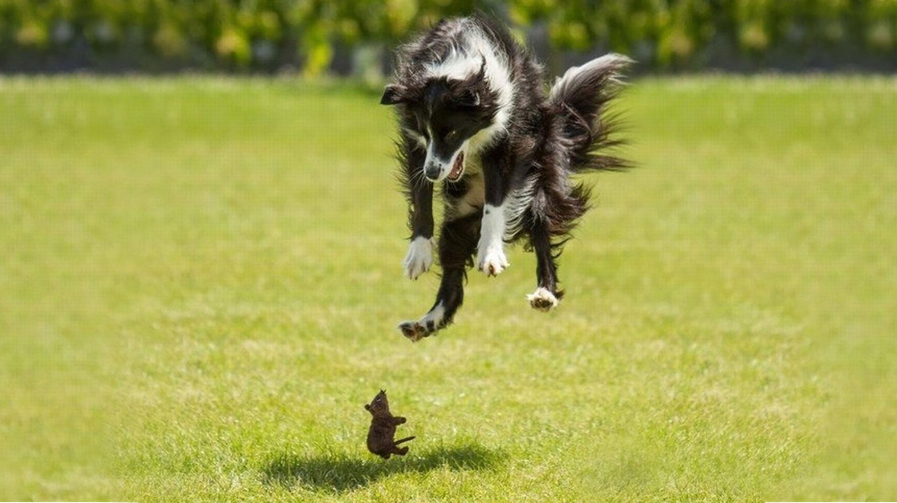

Slide 8
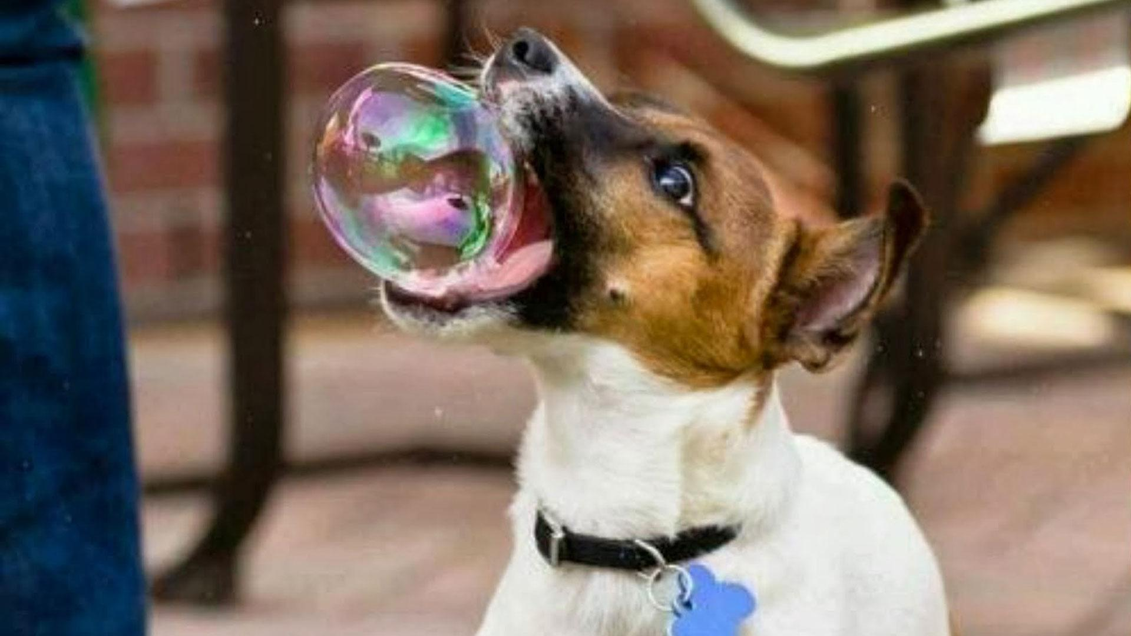

Slide 9
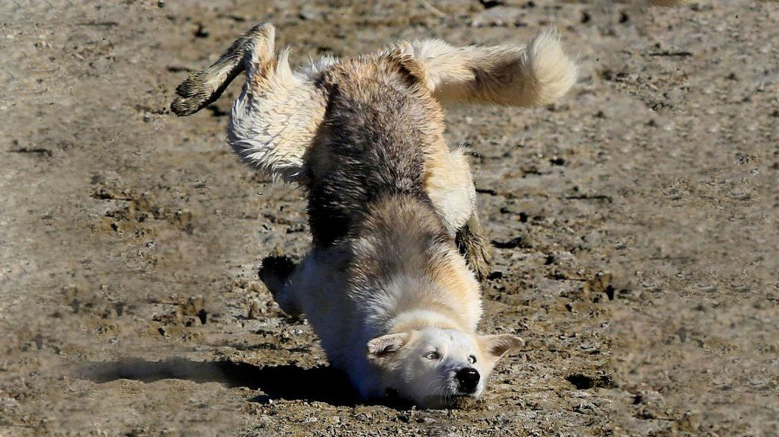

Slide 10
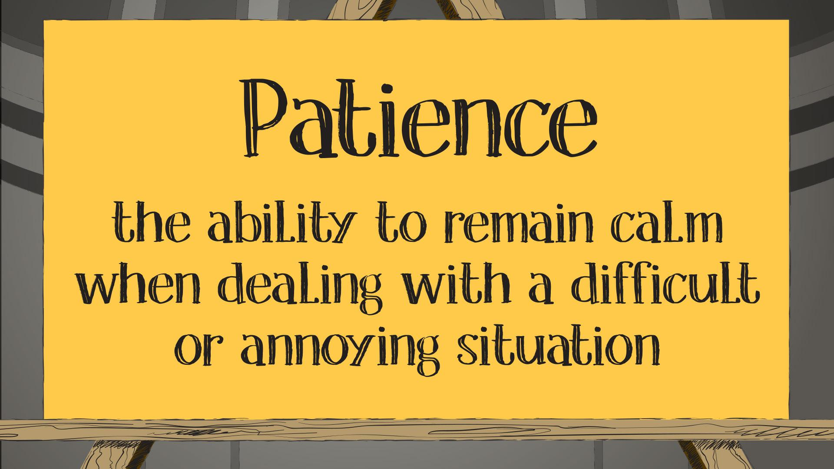

Slide 11
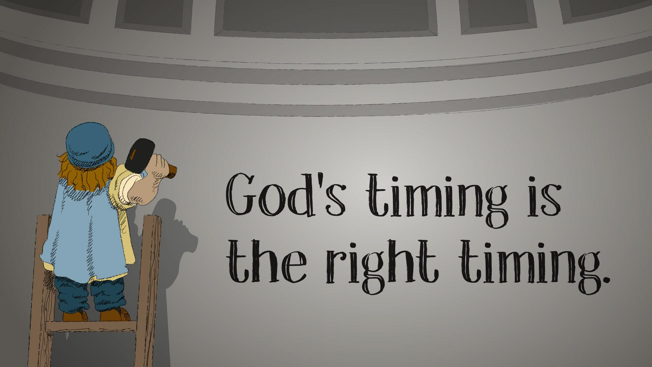

Slide 13
The PowerPoint slide for the Younger Adaptation is found below.
If you are choosing to use the Younger Adaptation portion of the lesson, be sure to modify the PowerPoint to include the Younger Adaptation visual and link.

Slide 14
Video

Slide 15
The additional slides below are provided so the PowerPoint can be adapted to best fit your needs.

Slide 16


Slide 17


Slide 18


